Slide 1
2016 INVASIVE SPECIES (B&C)
KAREN LANCOUR
National Rules Committee Chairman- Life Sciences

Slide 2
Event Rules – 2016
DISCLAIMER
This presentation was prepared using draft rules. There may be some changes in the final copy of the rules. The rules which will be in your Coaches Manual and Student Manuals will be the official rules.

Slide 3
Event Rules – 2016
BE SURE TO CHECK THE 2016 EVENT RULES FOR EVENT PARAMETERS AND TOPICS FOR EACH COMPETITION LEVEL
The National INVASIVE SPECIES List is at www.soinc.org under Event Information

Slide 4
Invasive Species (B&C)
Content:
Taxonomic Scheme of the 2016 Official Science Olympiad NATIONAL INVASIVE SPECIES List
States may have their own State Invasive Species List for regional and state competitions – see your state website.
Event Parameters: see 2016 Official Rules – there is no field guide available so students will make their own binder for use in the competition. See the handout “Preparing a Resource Binder” to help make your own field guide.

Slide 5
TRAINING MATERIALS
Training Power Point – content overview
Training Handouts - background information and guide to making a field guide.
Sample Tournament – sample problems with key
based upon the National Invasive Species List
Event Supervisor Guide – event prep tips, setup needs and scoring tips
Internet Resources & Training Materials – on the Science Olympiad website at www.soinc.org
under Event Information
A Biology-Earth Science (2016) CD, and the Taxonomy CD (2016) are available from SO store at www.soinc.org

Slide 6
COLLECTING SPECIMENS WARNING
THERE ARE NATIONAL AND STATE LAWS AND REGULATIONS CONCERNING THE COLLECTIONS AND TRANSPORT OF INVASIVE SPECIES.
CHECK WITH YOUR STATE INVASIVE SPECIES PAGE, DNR, AND/OR STATE OTHER OFFICALS BEFORE COLLECTING SPECIMENS.

Slide 7
GAME PLAN
Use the POWERPOINT for an overview
Study the TWO HANDOUTS – for background information and as a guide to making a binder and learning the competition
Use the INTERNET RESOURCES and CD’S for more help – see the Science Olympiad National website at www.soinc.org under event information and the Science Olympiad store
Prepare a BINDER and use OTHER TOOLS to LEARN THE INVASIVE SPECIES and then MODIFY THE BINDER for effective use in competition
Do the SAMPLE TOURNAMENT under timed conditions to experience being timed in competition.
Prepare and do PRACTICE STATIONS, OLD TESTS, and INVITATIONALS –to master knowledge, teamwork, and using your binder effectively under timed conditions.

Slide 8
INVASIVE SPECIES PROBLEMS
World-wide problem
Increase in travel and trade open routes
In U.S. costs $137 billion dollars per year
Approximately 42% of Threatened or Endangered species are at risk due to non-native, invasive species.
Raise havoc in ecosystems and threaten species diversity

Slide 9
Terminology
Native – species found within its natural range
Non-native (introduced, alien, exotic, non-indigenous) – a species living outside it native distribution range which has arrived there by human activity either deliberate or accidental.
Note: non-native, introduced, exotic, non-indigenous and alien are often used interchangeably.
Feral (released pets, livestock and game animals) – an animal living in the wild but descended from domesticated individuals
Human commensal or subsidized (out of control natives) - native species that benefit from our land use (disturbance)
Invasive species - species that spread subsequent to establishment usually at some cost. US legal definition - an alien species whose introduction does or is likely to cause economic or environmental harm or harm to human health.

Slide 10
Overview of Situation

Slide 11
Causes of Invasion
Introduced as a result of human activity – estimated 50,000 exotic organisms released in US every year – globalization has increased individual and commercial long distance travel and trade resulting in the altering of important waterways. Non-native species are introduced as a result and some species become invasive species.
10% Rule – Only 10% of introduced exotics will live at all due to wrong climate, food availability and other factors; of the 10% that live, only 10% will actually breed and become invasive – EPA estimates. 6,500 established invasive species in the U.S. (USGS)

Slide 12
Vectors or Modes for Invasion

Slide 13
Intentional Release
Intentional Release- Release of Target Species into the Environment
Economic Purposes – nutria
Plants for Agriculture
Plants for Forestry
Plants for Soil Improvements - fire suppression, erosion control
Aesthetic reasons – honeysuckle, purple loosestrife
Ornamental Plants
Cultural Purposes – starlings, Asian Shore crabs
Birds and Mammals for Hunting
Misguided Environmental Projects – Kudzu, Multiflora rose
Biological Control – species intended as controls become invasive
Released Pets and Pet Trade
Naturalization societies
Shakespeare fans – plan to release all birds mentioned in works of Shakespeare – 12 birds released including European Starling
Domestic animals
Release of lab animals or plants – by science teachers and researchers

Slide 14
Accidental Release
Accidental Releases - Release of Non-Target Species
Ballast water in ships (Green crab, Zebra Mussel, Comb Jellyfish)
Canals – as St. Lawrence River & Great Lake system
Timber – unprocessed wood
Accident release of organisms – gypsy moth, “Killer” African bees
Contaminants of Seed Stock
Fruit Shipments
Transfer in packing material (European Green Crab to CA, Horned Asian Beetle)
By-pass natural barriers
Cars and Planes
Tourists, Luggage
As Hitchhikers with Packing Material, Cargo
As Contaminants or Hitchhikers with Produce
As Contaminants or Hitchhikers with Ornamental Plants
As Contaminants or Hitchhikers with Aquaculture

Slide 15
Effects of Invasive Species on Ecosystems
Direct competition with native species
Lose of species diversity – may cause native species to become endangered
Short-circuit interactions in natural communities & disrupt natural food web
Affect entire ecosystem functions as water availability and nutrient cycle

Slide 16
ECONOMIC EFFECTS
Billions of dollars in damage to forests, property values, agricultural productivity, public utility operations, native fisheries, tourism, outdoor recreation
Billions of dollars in programs by federal and state agencies to control invasive species
$137 billion in damages per year

Slide 17
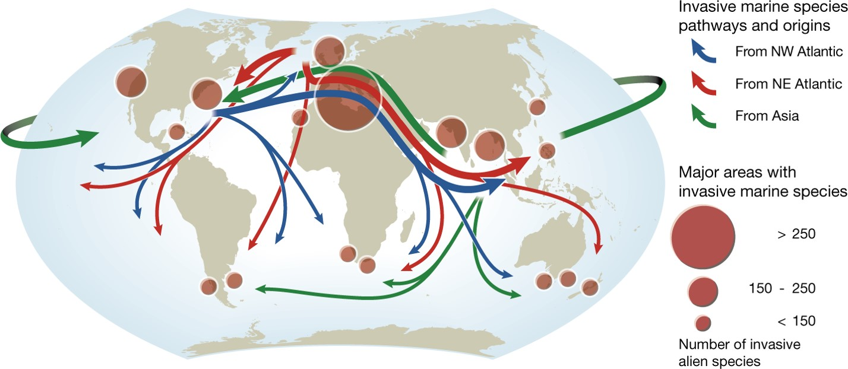
Tracking the Aquatic Invasive Species

Slide 18
Invasive Species by State

Slide 19
Invasion Process

Slide 20
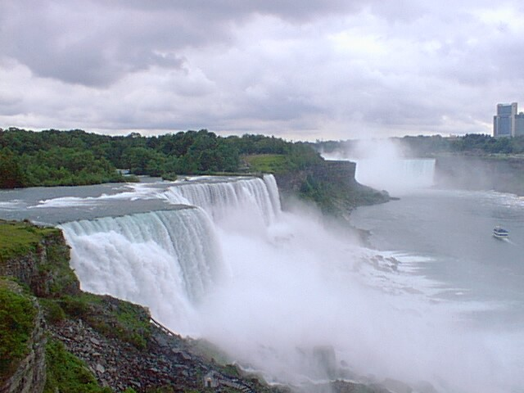
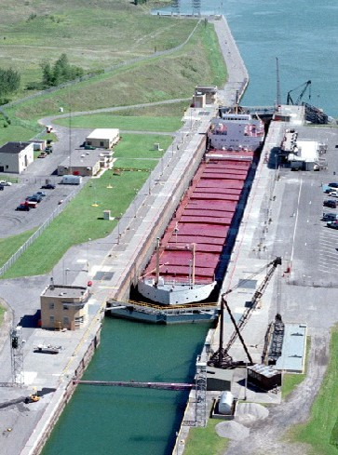
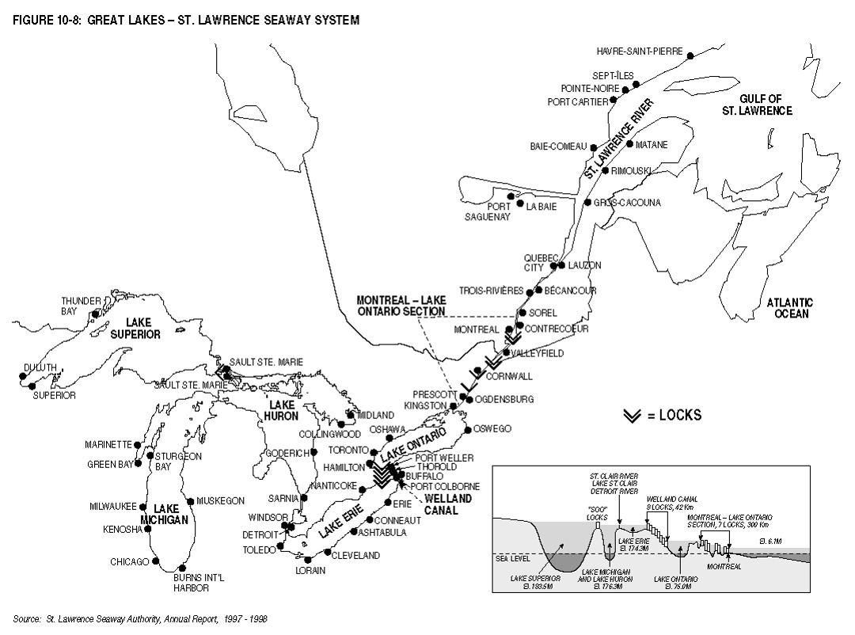
EXAMPLE OF INVASIVE PROCESS
The St. Lawrence Seaway is the common name for a system of canals that permits ocean-going vessels to travel from the Atlantic Ocean to the North American Great Lakes, as far as Lake Superior.
Niagara Falls was a major challenge – Weland Canal lock system set up to bypass falls
The Seaway opened in 1959 and cost $470 million US dollars.

Slide 21
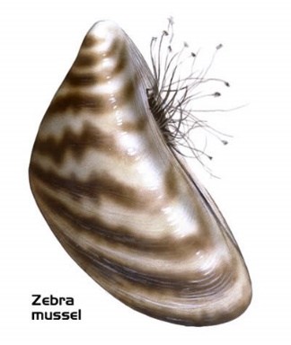
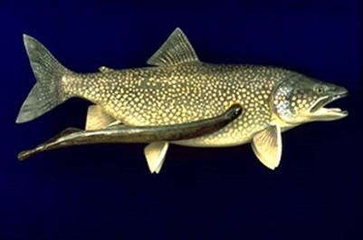
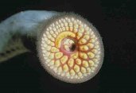
Result of St. Lawrence Seaway
The creation of the seaway also led to the introduction of foreign species of aquatic animals, including the sea lamprey, alewife, and the zebra mussel as well as plant species into the Great Lakes Basin.
These organisms were introduced via ballast water from oceanic vessels.

Slide 22
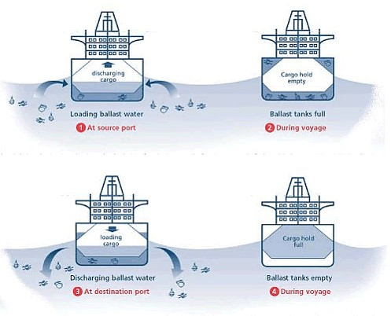
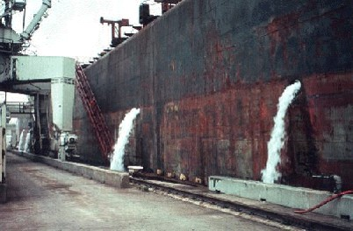
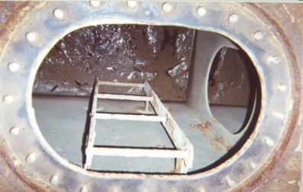
Ballast Water Problem

Slide 23
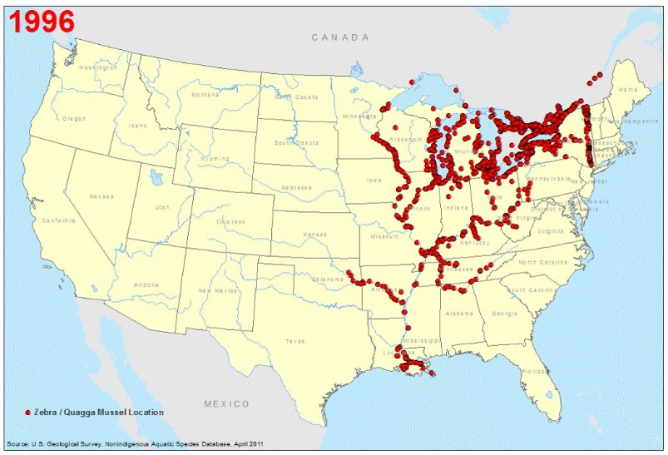
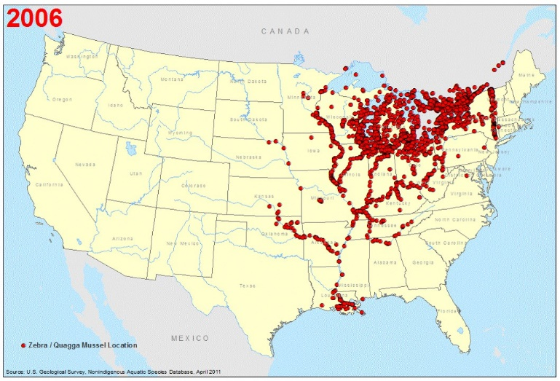
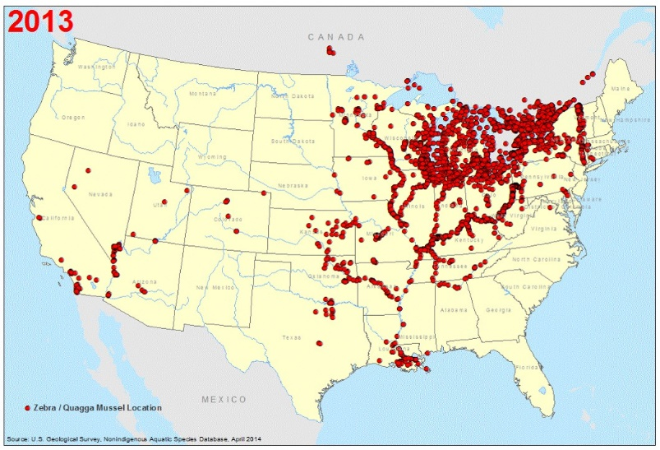
Zebra Mussel Spread

Slide 24
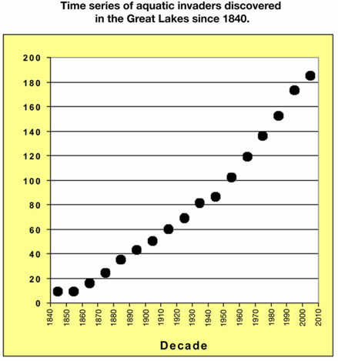
Invasive Species Increase in Great Lakes

Slide 25
Characteristics of Invasive Species

Slide 26
Invasion Curve

Slide 27
Timing for the Control of Invasive Species

Slide 28
Control Methods
Prevention
Eradicating potential invaders soon after invasion
Physical (manual & mechanical)
Cultural – Ecosystem Management
Biological – natural enemies
Chemical - pesticides
Integrated Pest Management – Uses a combination of methods – OFTEN MOST EFFECTIVE

Slide 29
Side Effects of Control Methods
Biological – control species can become invasive
Chemical – may kill native species
Physical – may miss removing some of the invasive species
Prevention – apathy and lack of awareness

Slide 31
LAWS & REGULATIONS – FEDERAL
NISA – National Invasive Species Act - ANS “Aquatic Nuisance Species” Task Force
Executive Order 13112 on Invasive Species – coordinates activities of government agencies
The Lacy Act – regulates import and transport of species
USDA APHIS – US Dept. of Agriculture Animal and Plant Health Inspection Service
CDC – Center for Disease Control

Slide 32
LAWS & REGULATIONS – STATE & LOCAL
Individual States have laws and regulations to control and prevent the spread of Invasive Species
http://www.invasivespeciesinfo.gov/laws/statelaws.shtml
Check with your local extension agency or government agencies before collecting any invasive species

Slide 33
National Invasive Species List
Organized by groups of organisms
Organized alphabetically by common name within the group to match USDA National Invasive Species List of Profiles
http://www.invasivespeciesinfo.gov/index.shtml
Browse in Animals for Insects/other Invertebrates,
Aquatic Species for Animals & Plants, Plants, and
Microbes for Fungi and Viruses
USDA profiles also have other resource links

Slide 34
State Invasive Species Lists
Individual states may make a State Invasive Species list for regional and state competitions
It should be listed on the State Science Olympiad website – hopefully the state will put a link to the state resources on their website for you
It may be organized differently than the National Invasive Species List- by Scientific Name rather than Common Name
State links-www.naisn.org/documents/compendium%20for%20website_links.pdf

Slide 35
RESOURCE BINDER HANDOUT
Posted on the National website under Event Resources for Invasive Species (B and C sections)
Organizational tips
What should be included for each specie
Sample format for profile or fact page
Sample fact page for an Invasive Species
Internet links to resources for binder and field guides available for states or regions
Other formats that can be uses as power points, flashcards, electronic binders

Slide 36
Study Binder - to Learn the Invasive Species
The most effective resources are produced by the students.
The process of producing the resources is a major learning tool.
Put a copy of the rules
Put a copy of NATIONAL & STATE INVASIVE SPECIES LISTS & Background Information
Prepare and organize materials by major topic divisions
Make a Fact Sheet or Profile for Each Invasive Species
Reduce the size of pictures where possible to get more information on a page. Save pictures as jpeg to avoid add-ons
Color code information to help you locate or emphasize
Put pages in sheet protectors – two per protector to save space.
Use tabs to separate sections and label tabs so items can be located with ease.

Slide 37
Electronic Binders
Power point by Mark VanHecke posted on National website under Event Resources for Invasive Species
The power point teaches you how to set up the Electronic Notebook
The process of producing the resources is a major learning tool.
Put in a copy of the rules
Put a copy of NATIONAL & STATE INVASIVE SPECIES LISTS & Background Information
Prepare and organize materials by major topic divisions
Make a Fact Sheet or Profile for Each Invasive Species
Organize the Binder to fit the State or National List that will be used in the competition
Share the information with your partner electronically
Use it as a resource to Learn the Invasive Species

Slide 38
Power Point Slides
Make power point slides for each of the species
Make them so information can they can be used for practice
Prepare them so they can be reorganized to make practice competitions for study
Make sample stations for practice

Slide 39
Flash Cards
Make flash cards with pictures on one side and information on the back
Use the flash cards to learn the Invasive Species
Use the flash cards to make up sample competitions stations

Slide 40
Competition Binder
Remember that most stations in competition have only 1.5 to 2 minutes – large binders with hundreds of pages are not effective
The best solution is to learn the Invasive Species –Be familiar with both common names and scientific names
As you learn the Invasive Species, reduce the size of the resources that you need
Modify your binder for competition as time effective as possible and practice using it under timed conditions before your competition

Slide 41
Practice Competitions
Make up sample stations – see station topics on the binder handout
Do the Sample Tournament under timed conditions
Do previous Competitions from Science Olympiad CD’s or Internet resources
Go to Invitational Competitions

Slide 42
Doing the Competition
Place information in appropriate place on answer sheet
Print legibly so information is understandable
Work as a team – use time effectively
Use Your Resource Binder effectively
Be sure to spell names correctly
Carefully read all questions and use common sense in answering
Relax, Do your best, and Have Fun!!

