Slide 1

2016 Anatomy & Physiology (B & C)
Karen Lancour Patty Palmietto
National Bio Rules National Event
Committee Chairman Supervisor – A&P

Slide 2
Event Rules – 2016
DISCLAIMER
This presentation was prepared using draft rules. There may be some changes in the final copy of the rules. The rules which will be in your Coaches Manual and Student Manuals will be the official rules.

Slide 3
Event Rules – 2016
BE SURE TO CHECK THE 2016 EVENT RULES FOR EVENT PARAMETERS AND TOPICS FOR EACH COMPETITION LEVEL

Slide 4
NEW ROTATION SCHEME
Year 1 Skeletal Muscular Integumentary (2016 and 2020)
Year 2 Nervous Sense Organs Endocrine (2017 and 2021)
Year 3 Respiratory Digestive Immune (2018 and 2022)
Year 4 Cardiovascular Lymphatic Excretory (2019 and 2023)

Slide 5
ANATOMY & PHYSIOLOGY
  Event Content: 2016 – YEAR 1 OF 4 YR ROTATION
  BASIC ANATOMY AND PHYSIOLOGY
    Skeletal System
    Muscular System
    Integumentary System
    Major disorders
    Treatment and prevention of disorders
  PROCESS SKILLS - observations, inferences, predictions, calculations, data analysis, and conclusions.

Slide 6
TRAINING MATERIALS
Training Power Point – content overview
Training Handouts – General and Systems
Sample Tournament – sample problems with key
Event Supervisor Guide – prep tips, event needs, and scoring tips
Internet Resource & Training CD’s – on the Science Olympiad website at www.soinc.org under Event Information
Biology-Earth Science CD, Anatomy/A&P CD (updated 2016) as well as the Division B and Division C Test Packets are available from SO store at www.soinc.org

Slide 7

SKELETAL SYSTEM
Karen Lancour Patty Palmietto
National Bio Rules National Event
Committee Chairman Supervisor – Health
karenlancour@charter.net Science

Slide 8
Skeletal System - Functions
Support & shape to body
Protection of internal organs
Movement in union with muscles
Storage of minerals (calcium, phosphorus) & lipids
Blood cell production

Slide 9
The Skeletal System
Know the Skeletal Anatomy
Axial Skeleton
Appendicular Skeleton
Surface Anatomy of the bone
  By x-ray or diagram
Structure/function of joints, muscle and ligament attachments
  Including range of motion

Slide 10
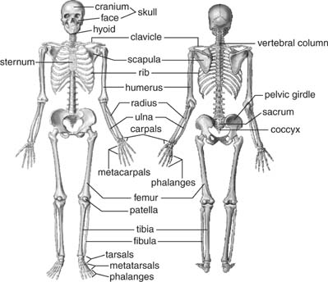
Human Skeleton
206 Bones
Axial skeleton: (80 bones) in skull, vertebrae, ribs, sternum, hyoid bone
Appendicular Skeleton: (126 bones)- upper & lower extremities plus two girdles
Half of bones in hands & feet

Slide 11
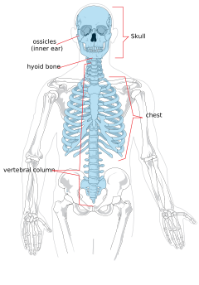
Axial Skeleton (80)
Skull
Ossicles of the middle ear
Hyoid bone
Thorax or chest
Vertebral column

Slide 12
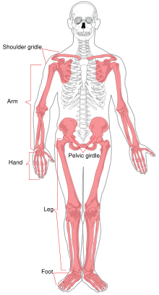
Appendicular
Skeleton (126)
Upper Extremity (64)
Shoulder Girdle
Arms
Hands
Lower Extremity (62)
Pelvic Girdle
Legs
Feet

Slide 13
Types of Bone
Long bones: longer than they are wide; shaft & 2 ends (e.g.: bones of arms & legs,except wrist, ankle & patella)
Short bones: roughly cube-shaped (e.g.: ankle & wrist bones)
Sesamoid bones: short bones within tendons (e.g.: patella)
Flat bones: thin, flat & often curved (e.g.,: sternum, scapulae, ribs & most skullbones)
Irregular bones: odd shapes; don't fit into other classes (e.g.: hip bones & vertebrae)

Slide 14
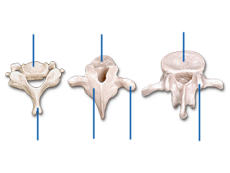
Types of Vertebrae
Cevical (7)
  Atlas
  Axis
Thoracic (12)
Lumbar (5)

Slide 15
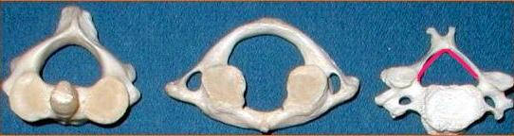
Cervical Vertebrae
Atlas – 1st; supports head
Axis – 2nd; dens pivots to turn head

Slide 16
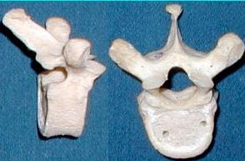
Thoracic Vertebrae
long spinous
processes
rib facets

Slide 17
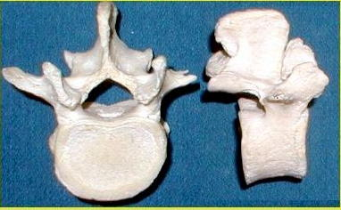
Lumbar Vertebrae
large bodies
thick, short
spinous
processes

Slide 18
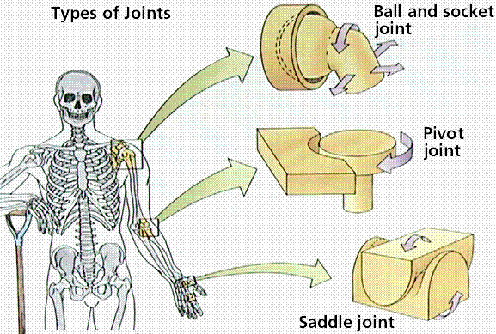
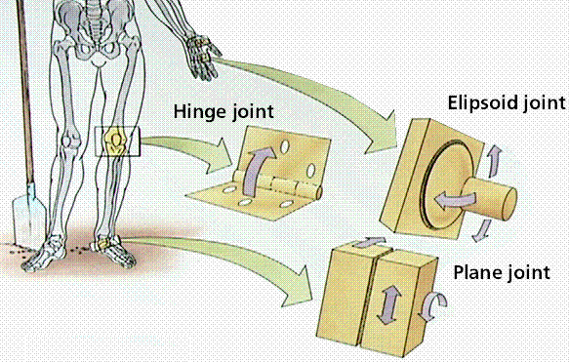
Joints
Ball & Socket
Pivot
Saddle
Hinge
Elipsoid (Condyloid)
Plane or Gliding - vertebrae

Slide 19
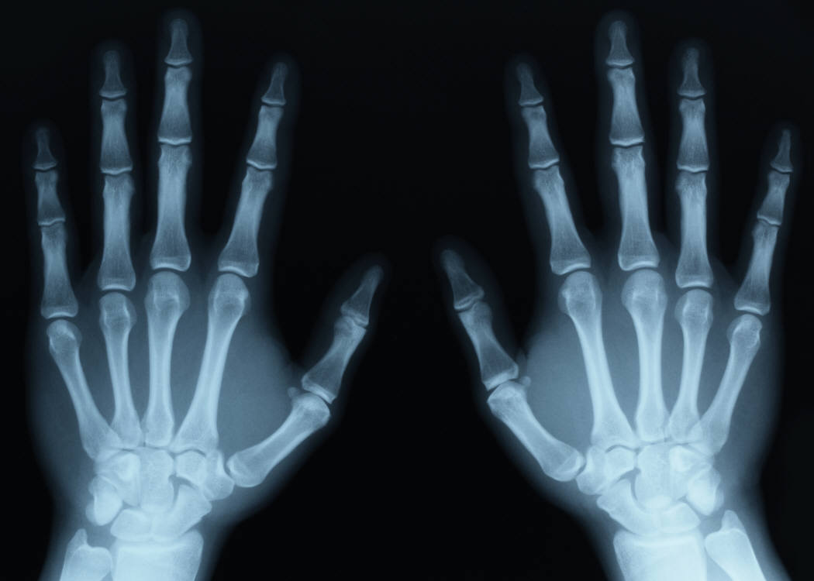
Bones – Cellular & Physiology
Cross section structures
Cellular composition
Bone marrow
Cartilage
Fractures

Slide 20
Bone Cells
Osteoblasts – bone forming cells synthesize and secrete unmineralized ground substance and are found in areas of high metabolism within the bone
Osteocytes – mature bone cells made from osteoblasts that have made bone tissue around themselves. They maintain healthy bone tissue by secreting enzymes and controlling the bone mineral content; they also control the calcium release from the bone tissue to the blood.
Osteogenic cells respond to traumas, such as fractures, by giving rise to bone-forming cells and bone-destroying cells
Osteoclasts – bone absorbing cell – large cells that break down bone tissue – important to growth, healing, remodeling
Bone lining cells - made from osteoblasts along the surface of most bones in an adult. Bone-lining cells are thought to regulate the movement of calcium and phosphate into and out of the bone

Slide 21
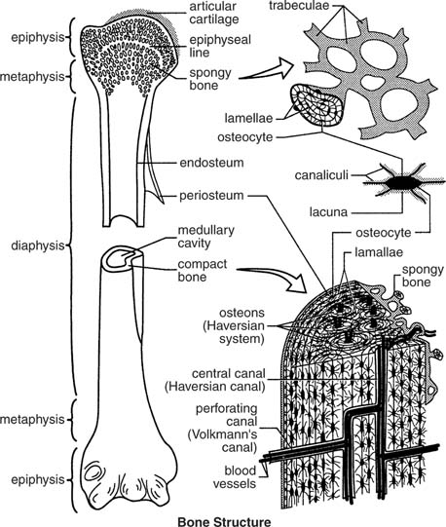
Long Bone Structure
Compact Bone
  Outer Layer
  Haversian System
Spongy Bone
  Ends of long bones
Cartilage

Slide 22
Red and Yellow
Bone Marrow
The formation of blood cells, (hematopoiesis), takes place mainly in the red marrow of the bones.
In infants, red marrow is found in the bone cavities. With age, it is largely replaced by yellow marrow for fat storage.
In adults, red marrow is limited to the spongy bone in the skull, ribs, sternum, clavicles, vertebrae and pelvis. Red marrow functions in the formation of red blood cells, white blood cells and blood platelets.

Slide 23
Cartilage – Characteristics
Mostly water; no blood vessels or nerves
Tough, resilient
New cartilage forms from chondroblasts
Heal poorly

Slide 24
Types of Skeletal Cartilage
Hyaline Cartilages: fine collagen fiber matrix- most abundant type- found in articular (movable joint) cartilages, costal cartilages (connect ribs tosternum), respiratory cartilages (in larynx & upper respiratory passageways) & nasal cartilages
Elastic Cartilages: similar to hyaline cartilage, more elastic fibers (very flexible) – found in external ear & epiglottis (larynx covering)
Fibrocartilage: rows of chondrocytes with thick collagen fibers; highly compressible with great tensile strength- found in menisci of knee, intervertebral discs & pubic symphysis

Slide 25
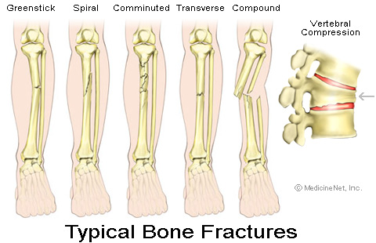
Fractures of the Bone
Know fractures based on diagrams or by x-ray recognition

Slide 26
Bone Repair Sequence
Injury – broken blood vessels, hematoma
Invasion of blood vessels & generalized cells (2-3 days)
Fibroblasts develop (1 week)
Chondroblasts develop
Callus forms (4 weeks)
Remodeling with osteoclasts (8 weeks)

Slide 27
Disease/Injury Levels
Osteoarthritis
Osteoporosis
Fractures (via pictures and x-rays)
Disc herniation
Scoliosis
ACL and MCL injuries

Slide 28
MUSCULAR SYSTEM
Karen Lancour Patty Palmietto
National Bio Rules National Event
Committee Chairman Supervisor – Health
karenlancour@charter.net Science

Slide 29
MUSCULAR SYSTEM
Muscle Function:
Stabilizing joints
Maintaining posture
Producing movement
Moving substances within the body
Stabilizing body position and regulating organ volume
Producing heat– muscle contraction generates 85% of the body’s heat

Slide 30
Characteristics of Muscle Tissue
Excitability- receive and respond to stimuli
Contractility- ability to shorten and thicken
Extensibility- ability to stretch
Elasticity- ability to return to its original shape after contraction or extension

Slide 31
Types of Muscle

Slide 32
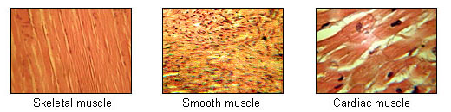
Types of Muscle

Slide 33
Skeletal Muscles
Nearly 650 muscles are attached to the skeleton. See muscle list for competitions.
Skeletal muscles- work in pairs: one muscle moves the bone in one direction and the other moves it back again.
Most muscles- extend from one bone across a joint to another bone with one bone being more stationary than another in a given movement.
Muscle movement- bends the skeleton at moveable joints.
Tendons - made of dense fibrous connective tissue shaped like heavy cords anchor muscles firmly to bone.
Tendon injury- though very strong and secure to muscle, may be injured.

Slide 34
Skeletal Muscles
origin - Attachment to the more stationary bone by tendon closest to the body or muscle head or proximal
insertion - attachment to the more moveable bone by tendon at the distal end
During movement, the origin remains stationary and the insertion moves.
The force producing the bending is always a pull of contraction. Reversing the direction is produced by the contraction of a different set of muscles.
As one group of muscles contracts, the other group stretches and then they reverse actions.

Slide 35
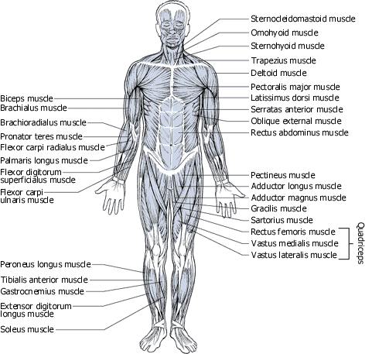
Front

Slide 36
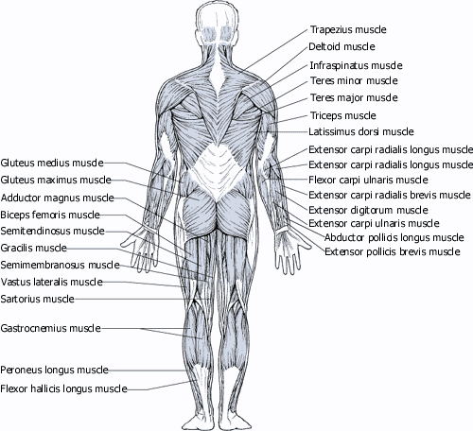
Back

Slide 37
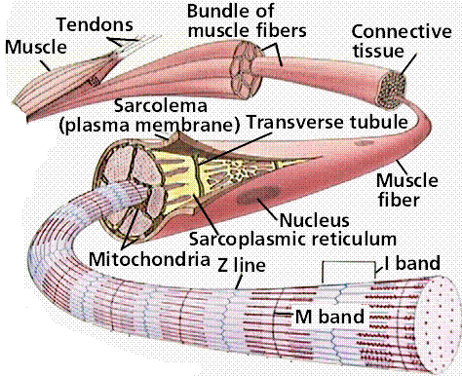
Skeletal
Muscle
Anatomy
Each muscle- has thousands of muscle fibers in a bundle running from origin to insertion bound together by connective tissue through which run blood vessels and nerves.
Each muscle fiber - contains many nuclei, an extensive endoplasmic reticulum or sarcoplasmic reticulum, many thick and thin myofibrils running lengthwise the entire length of the fiber, and many mitochondria for energy

Slide 38
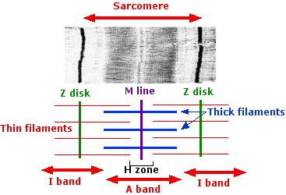
Sarcomere
sacromere -The basic functional unit of the muscle fiber consists of the array of thick and thin filaments between two Z disks.
thick filaments - with myosin (protein) molecules
thin filaments - with actin (protein) molecules plus smaller amounts of troponin and tropomysin.
striations -of dark A bands and light I bands.
A bands- are bisected by the H zone with the M line or band running through the center of this H zone.
I bands- are bisected by the Z disk or line.

Slide 39
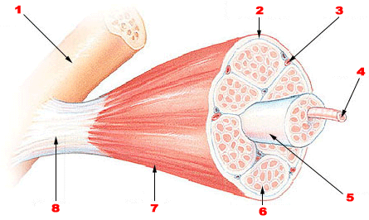
Skeletal muscle
Bone
Perimysium
Blood vessel
Muscle fiber
Fascicle
Endomysium
Epimysium
Tendon

Slide 40
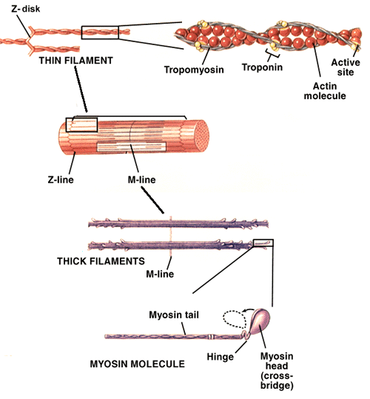
Sliding-Filament Model
Thick filaments, - myosin molecules contain a globular subunit, the myosin head, which has binding sites for the actin molecules of the thin filaments and ATP.
Activating the muscle fiber causes the myosin heads to bind to actin molecules pulling the short filament a short distance past the thick filaments.
Linkages break and reform (using ATP energy) further along the thick filaments.
Ratchet-like action pulls the thin filaments past the thick filaments in a.
Individual filaments - No shortening, thickening or folding occurs.

Slide 41
Muscle Contraction
As the muscle contracts - the width of the I bands and H zones decrease causing the Z disks to come closer together, but there is no change in the width of the A band because the thick filaments do not move.
As the muscle relaxes or stretches - the width of the I bands separate as the thin filaments move apart but the thick filaments still do not move.

Slide 42
Muscle and Tendon Injuries
Strains – injuries from overexertion or trauma which involve stretching or tearing of muscle fibers. They often are accompanied by pain and inflammation of the muscle and tendon.
Sprain - the injury near a joint and involves a ligament
Cramps – painful muscle spasms or involuntary twitches.
Stress-induced muscle tension – may cause back pain and headaches.

Slide 43
Muscular Disorders
Poliomyelitis – viral infection of the nerves that control skeletal muscle movement.
Muscular Dystrophies – most common caused by mutation of gene for the protein dystrophin which helps in attaching and organizing the filaments in the sacromere. Duchenne Muscular Dystrophy and Becker muscular dystrophy are the two most common types. The gene for dystrophin is on the X chromosome so the disorder is sex-linked.
Myasthenia Gravis – autoimmune disease affecting the neuromuscular junction. affecting the ability of the impulse to cause the muscle contraction. Administering an inhibitor of acetylcholinesterase can temporarily restore contractibility.

Slide 44
Effects of Exercise on Muscular System
Exercise helps muscles become more effective and efficient.
Tendons will become thicker and stronger
High intensity exercise for short duration produces strength, size and power gains in muscles
Low intensity exercise for long durations will give endurance benefits
Trained muscles have better tone or state of readiness to respond
Exercise promotes good posture enabling muscles to work effectively and helps prevent injury

Slide 45
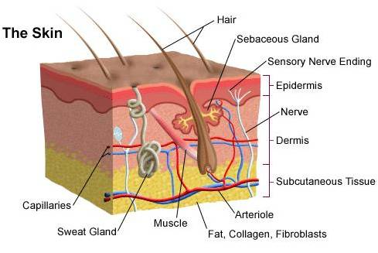
Integumentary System
The integumentary system consists of the skin, hair, nails, the subcutaneous tissue below the skin, and assorted glands

Slide 46
Skin Functions
Protection from injury
Protection against infection
Regulates body temperature
Regulates water loss
Chemical synthesis
Sensory perception

Slide 47
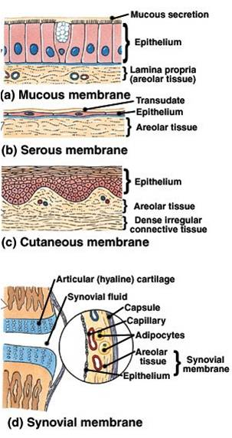
Types of Membranes
Serous Membranes
  Line body cavities that have no opening to the outside
  Secrete a watery fluid called serous fluid that lubricates surfaces
Mucous Membranes
  Line cavities and tubes that open to the outside
Synovial Membranes
  Form the inner lining of joint cavities
  Secrete a thick fluid called synovial fluid
Cutaneous Membrane – also
known as skin

Slide 48
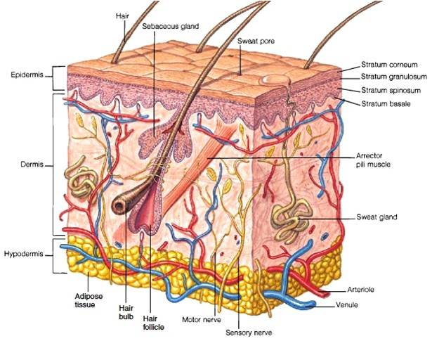
Skin Layers and Attachment Layer
Epidermis
Covers internal + external surfaces of body
Dermis
Inner layer – Contains
accessory skin structures
Hypodermis or subcutaneous layer
Attaches the skin to underlying organs & tissues

Slide 49
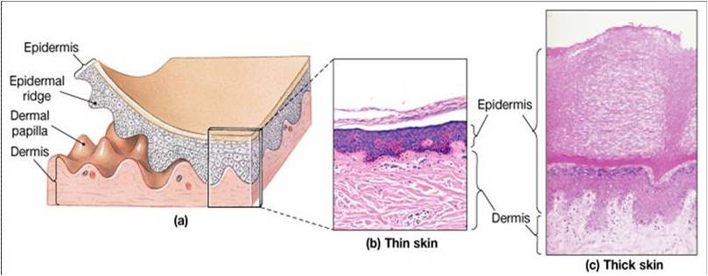
Thin skin vs. Thick skin
Thin - 1-2 mm on most of the body and 0.5 mm in eyelids – Hairy; Covers all parts of the body except palms, soles
Thick - up to 6 mm thick on palms of hands and soles of feet; Hairless; Covers palms, and soles

Slide 50
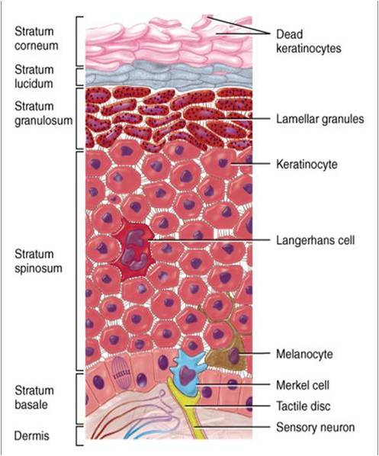
Epidermal Cell Types
Keratinocytes - 90 % of epidermal cells are keratinized contains keratin (fibrous protein) protects and waterproofs the skin
Melanocytes - 8% of the epidermal cells produces melanin contributes to skin color and absorbs UV light
Langerhans cells - Arise from red bone marrow and migrate to the epidermis -Constitute small portion of epidermal cells -Participate in immune responses Easily damaged by UV light
Merkel cells - Least numerous of the epidermal cells Found in the deepest layer of the epidermis-Along with tactile discs, they function in sensation of touch

Slide 51

Epidermal Layers
Stratum corneum - nuclei and organelles are destroyed by lysosomes and the cells fill with keratin
Stratum lucidum - only found in the palms and soles of feet 3-5 layers of clear, flat, dead keratinocytes -Dense packed intermediate filaments Thick plasma membranes
Stratum granulosum - cells start to become keritanized --Secretes lipid-rich secretion that acts as a water sealant
Stratum spinosum - 8-10 layers of keratinocytes
skin both strength and flexibility
Stratum basale - Also referred to as stratum germinatum -where new cells are formed -

Slide 52
Growth of Epidermis
      Newly formed cells in the stratum basale undergo keratinazation as they are pushed to the surface and accumulate more keratin during the process
      Then they undergo apoptosis or death
      Eventually they slough off and are replaced
      The process takes about 4 weeks
      Rate of cell division in the stratum basale increases during injury

Slide 53
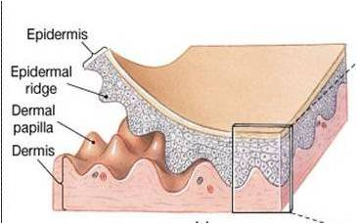
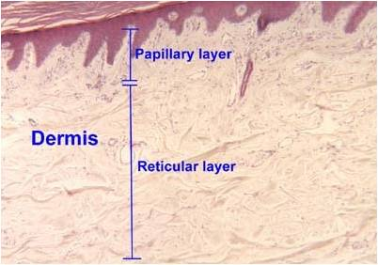
Dermis
    Second deepest part of the skin
    Composed mainly of connective tissues (collagen and elastic fibers)
    Papillary Layer – Surface area is increased due to projections called dermal papillae which contains capillaries or tactile receptors -Epidermal ridges conforms to the dermal papillae
    Reticular Layer -Contains hair follicles, nerves, sebaceous and sudoriferous glands

Slide 54
Hypodermis
(Subcutaneous) Attaches the skin to underlying organs and tissues
    Not part of the skin - lies below the dermis
    Contains connective tissue and adipose tissues (subcutaneous fat) for insulation
    Infants and elderly have less of this than adults and are therefore more sensitive to cold

Slide 55
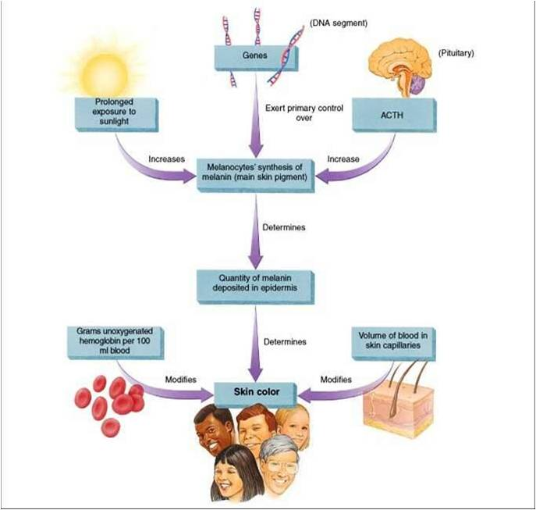
Skin Color

Slide 56
Skin Color
Genetic Factors – Skin pigmentation
  All humans have the same number of melanocytes
  How much melanin they produce is controlled by several genes
  Lack of pigment is called albinism
  Environmental Factors - Exposure to sunlight
Volume of Blood – Hemoglobin in blood

Slide 57
Skin Pigments – Melanin
    Located mostly in epidermis
    Two types of melanin: eumelanin which is brownish black and pheomelanin which is reddish yellow
    Fair-skinned people have more pheomelanin and dark skinned people have more eumelanin

Slide 58
Environmental Factors Affect Melanin Production
UV light increases enzyme activity in melansomes – increased melanin production
A tan = amount of melanin increases + darkness of melanin
Eumelanin = protection from UV radiation but pheomelin breaks down with too much UV
Too much UV radiation may cause skin cancer

Slide 59
Other Skin Pigments
Carotene = yellow -orange pigment
precurser of Vitamin A – important for vision
Found in Stratum corneum and fatty areas of dermis and hypodermal layer
Hemoblobin = oxygen carrying pigment in red blood cells

Slide 60
Skin Markings
friction ridges: markings on fingertips characteristic of primates - allow us to manipulate objects more easily-fingerprints are friction ridge skin impressions
flexion lines: on flexor surfaces of digits, palms, wrists, elbows etc.- skin is tightly bound to deep fascia at these points
freckles: flat melanized patches vary with heredity or exposure to sun
moles: elevated patch of melanized skin, of the with hair mostly harmless, beauty marks

Slide 61
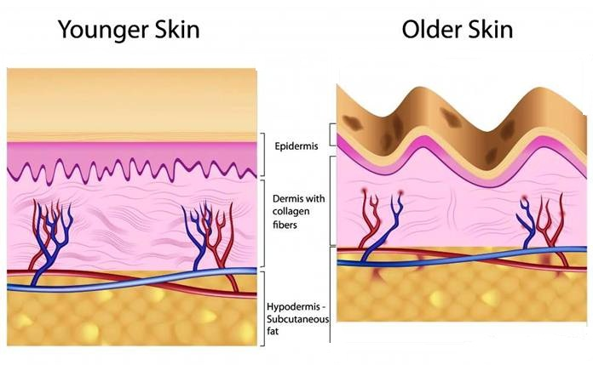
Aging Skin
In our 20s, the effects of aging begin to be visible in the skin.
Stem cell activity declines: skin thin, repair difficult
Epidermal dendritic cells decrease: reduced immune response
Vitamin D3 production declines: calcium absorption declines and brittle bones
Glandular activity declines: skin dries, body can overheat
Blood supply to dermis declines: tend to feel cold
Hair follicles die or produce thinner hair
Dermis thins and becomes less elastic – wrinkles

Slide 62
Skin Derivatives
During embryonic development thousands of small groups of epidermal cells from stratum basale push down into dermis to form hair follicles and glands

Slide 63
Functions – Hair & Nails
Functions of Hair
  Hair on the head protects scalp from injury and sunlight
  Eyelashes and eyebrows protect eyes
  Nostril and ear hairs protect from foreign particles
  Help in sensing light touch due to the touch receptors associated with the hair root plexuses.
Functions of the Nails
  Grasping objects
  Manipulating objects
  Protects ends of digits from trauma
  Scratching

Slide 64
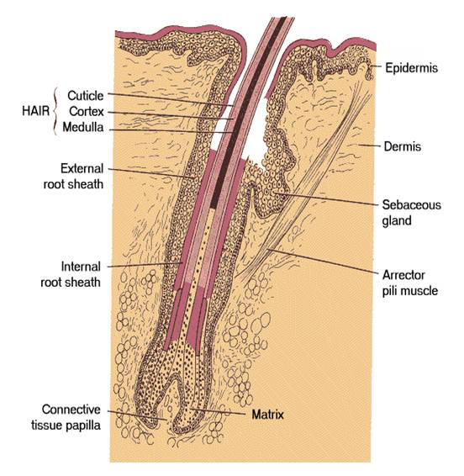
Hair Anatomy
Shaft: portion of hair that projects from skin surface
Root: portion of hair deep to the shaft penetrating the dermis
  Has 3 layers:
medulla
cortex
cuticle
Base of the hair follicle
  Bulb: houses the papilla which contains the blood vessels that nourishes the growing hair follicle.
  Matrix: responsible for hair growth and produces new hair
Arrector pili: smooth muscle
  Extends from the dermis to the side of hair follicle.
Hair root plexus - dendrites of neurons which are sensitive to touch

Slide 65

Hair Features
& Texture
About 100,000 hairs are on the scalp
Almost every part of body is covered with hair except palms of hands, soles of feet, sides of fingers and toes, lips and parts of genitals
Hair shafts differ in size, shape, and color. In the eyebrows they are short and stiff while on the scalp they are longer and more flexible. Over the rest of the body they are fine and nearly invisible
  Oval shaped hair shafts produce wavy hair,
  Flat or ribbon-like hair shafts produce curly or kinky
  hair
  Round hair shafts produce straight hair.
  Roughly 5 million hairs cover the body of an average individual

Slide 66
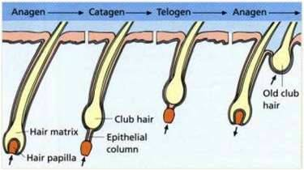
Hair Growth
Hair follicles grow in repeated cycles.
One cycle can be broken down into three phases.
Anagen - Growth Phase
Catagen – Transitional Phase
Telogen - Resting Phase
Each hair passes through the phases independent of the neighboring hairs

Slide 67
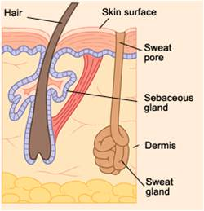
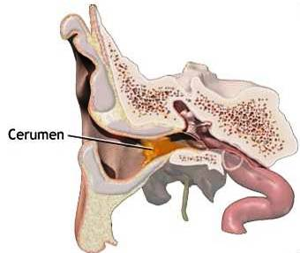
Skin Glands
Sudoriferous - sweat glands
Eccrine sweat glands -Secretes cooling sweat
Appocrine sweat glands - during emotional stress/excitement
    Sebaceous - oil glands –
    Acne - inflammation of sebaceous gland ducts
Ceruminous - modified sweat glands of the external ear that produce ear wax

Slide 68
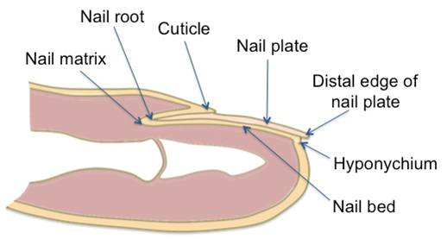
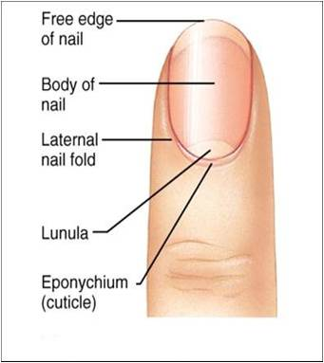
Nails
Made of tightly packed, hard, keratinized epidermal cells
Consist of:
Nail body: portion of the nail that is visible- Free edge: part that extends past the distal end of the digit
  Nail root: portion buried in a fold of skin
Lunula: means little moon - Crescent shaped area of the nail
Hyponychium: secures the nail to the fingertip -Thickened stratum corneum
Eponychium or cuticle: narrow band of epidermis-Growth of nails is in the nail matrix.

Slide 69
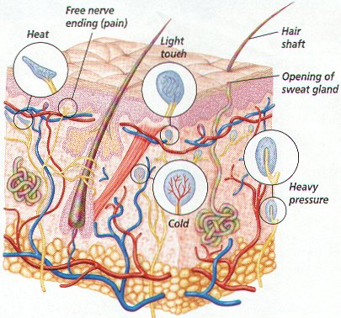
Skin Receptors
Heat
Cold
Light pressure
Heavy Pressure
Pain

Slide 70
Skin Imbalances
Skin Leisons
Skin Infections
Viral as cold sores, herpes simplex, warts (HPV)
Bacterial as bioles, carbuncles, inflammmation of hair follicles and subaceous glands. Impetigo
Fungal as athletes food, Tinea
Contact Dermatitis
Irritant Dermatitis as soaps, detergents, shampoo
Allergic Dermatitis as poison ivy, poison oak, rubber gloves, nickel and other medals, fragrances

Slide 71
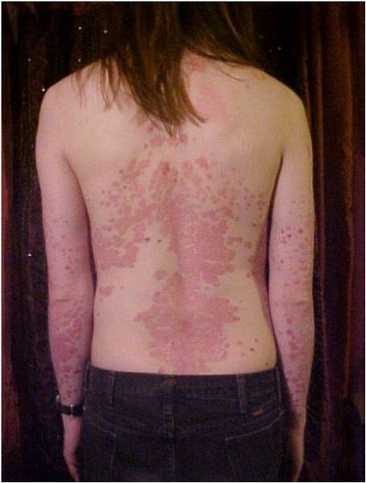
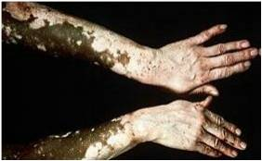
Genetic Disorders
Psoriasis
chronic, noninfectious skin disease
skin becomes dry and scaly, often with pustules and many varieties
stratum corneum gets thick as dead cells accumulate
often triggered by trauma, infection , hormonal changes or stress
Vitiligo – a autoimmune pigmentation disorder where melanocytes in the epidermis are destroyed eg Michael Jackson

Slide 72
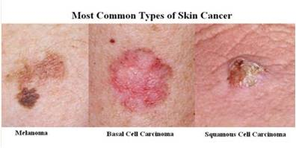
Skin cancer

Slide 73
Types of Skin Cancer
Basal Cell Carcinoma
  Spread uncommon, very curable if found early
Squamous Cell Carcinoma
  Occurs parts exposed to the sun

Slide 74
Types of Skin Cancer (cont.)
Malignant Melanoma
  Most common in southern hemisphere where the ozone layer is thin.
Deadly if not caught early!!

Slide 75
Skin Cancer
Very common
ABCD
  Asymmetry
  Borders
  Color
  Diameter

Slide 76
Skin Cancer Prevention
Use SPF 15 minimum.
Wear hats and shirts with sleeves.
Wear sunglasses to protect eyes from UV.
Avoid tanning beds

